Slide 1

Mini Project
Blood Bank Management System

Slide 2
Blood Bank Management System
Group Members
Snehasish Banik
(R17CS403)
Sriyansh Ghosh
(R17CS410)
T V Poonam
(R17CS426)
Group No: G12
Mini Project Guide:
Prof. Laxmi Jayannavar

Slide 3
Contents
Abstract
Introduction
Literature Survey
Objectives
System Design and Analysis
System Requirements
Methodology
Experimental Results
Applications
Conclusion
Future Enhancement
References

Slide 4
Abstract
Abstract—Availability of blood throughout emergencies is strong vital for each single object. There is a number of online blood donation centers uniting area for efficient contact between them and medical facilities. None of the net blood donation center offers immediate contact between both the donor and them. This may be the big downside of the new framework. The present bridges area unit fastidious; required additional job and large ticket. This paper provides a link between the current bank system and the improved performance structure. The current concerns might grow the effectualness of recent blood banks and facilitate new standard desktop framework to moveable framework. The proposed research each addresses the elements of expanded structure in different ways, such as the details being retained, knowledge provided and obtained by the individuals for potential projects such as relatively blood teams. Keywords— Blood Bank Management System (BBMS); Blood bank; donor; acceptors; administrator

Slide 5
Introduction
The "Blood donation center management program" was developed to alleviate the problems learned in the manual process for rehearsing. This drug is sponsored to eliminate and regularly diminish the burdens that this new system looks like. This structure is often meant for the organization's unique need to do operations in a seamless and viable manner. Nonetheless, the code is reduced as planned to keep away from errors when entering the information[1]. It additionally gives mistake message while entering invalid information. The consumer does not need traditional knowledge to use this platform. In that what it shows in these lines is simple to grasp. Blood donation center management system will prompt error free, safe, reliable[2-4]. It will help the client concentrate on their multiple tasks, rather than the record keeping.

Slide 6
Introduction(Cont.)
Each group, whether big or tiny, has difficulties in maintaining and coping with data from Blood Collection, Blood Supply, Blood Inventory, Report, Blood Cell in order to allow efficient usage of resources[5-6]. Blood Bank Management Scheme has distinctive needs for Blood Bank, thus structuring restrictive representative administrative systems that are tailored to the administrative preconditions[7]. It is designed to assist with crucial plans, which will help you insure that your organization is equipped with the appropriate degree of details which subtleties for your potential goals[8-10]. Likewise, our frameworks follow remote access highlights for those busy officials who are frequently in a rush, which will enable you to manage your employees reliably whenever appropriate[11-13]. At last, these structures would empower you to manage assets all the more possibly. II. BLOOD BA

Slide 7
Literature Survey
The website for Blood Bank India is a website that provides the facility for the donor to register by him or herself as a blood donor.
“Android Blood Bank” describes about the android application which timely updates the information regarding donors where the admin accesses the whole information about blood bank management system.
It is an information management system which helps to manage the records of donors and patients at a blood bank. The system will allow the authorized blood bank officer to login using a secret password and easily manage the records of the blood donors and the patients in need of blood.
The system will help control a blood transfusion service and create a database to hold data on stocks of blood in each area as data on donors in each city.

Slide 8
Gap Analysis
Maintenance and updating of blood bank records, currently, are done manually which, at times, results in loss of critically important records or delayed information updates.
Security of records are minimum.
Difficult of making reports.
It is difficult to identify the expiry date of the blood sample.

Slide 9
Objectives
The goals and objectives of the Blood Bank Management System are as follows:
To provide a means for the blood bank to publicize and advertise blood donation programs.
To allow the probable recipients to make search and match the volunteer donors, and make request for the blood.
To provide an efficient donor and blood stock management functions to the blood bank by recording the donor and blood details.
To improve the efficiency of blood stock management by alerting the blood bank staffs when the blood quantity is below it par level or when the blood stock has expired.

Slide 10
System design and Analysis
The system is designed and developed keeping in view that it should be user-friendly, Searching should be easy, and it should have the good and easy display and user ease is given to the user.
The Interface of the system is developed keeping in mind that it should be good looking, attract, at first sight, easy to understand and self-explanatory.
The system is web-based and the user can have access to the system with or without the internet. The interface of the system is so flexible that it can arrange itself according to the size of the device in which the site is being used.
The efficiency of any system is concerned with the minimum processing time as well as the optimal use of system resources in designing the proposed system; the efficiency factor has been taken well into consideration.

Slide 11
System design and Analysis(Cont.)
The interface will be user-friendly so that a common user can use it easily. In our, we make it very easy for the user to jump from one section to another. Another uniqueness of the design id that it is based on the fluid interface, it can adjust itself according to the device in which the system is being used.
Data security and integrity is our topmost priority. We will make sure that private data of every single user must remain confidential and never be compromised. For this purpose, we will use effective security mechanisms.

Slide 12
System Requirements
4GB RAM
Atleast 4GB disk space
Android Studio
XAMPP (Local Server)
Atleast core i3 processor
Any text editor (sublime,bracket,notepad++ etc.)
Windows OS/Linux

Slide 13
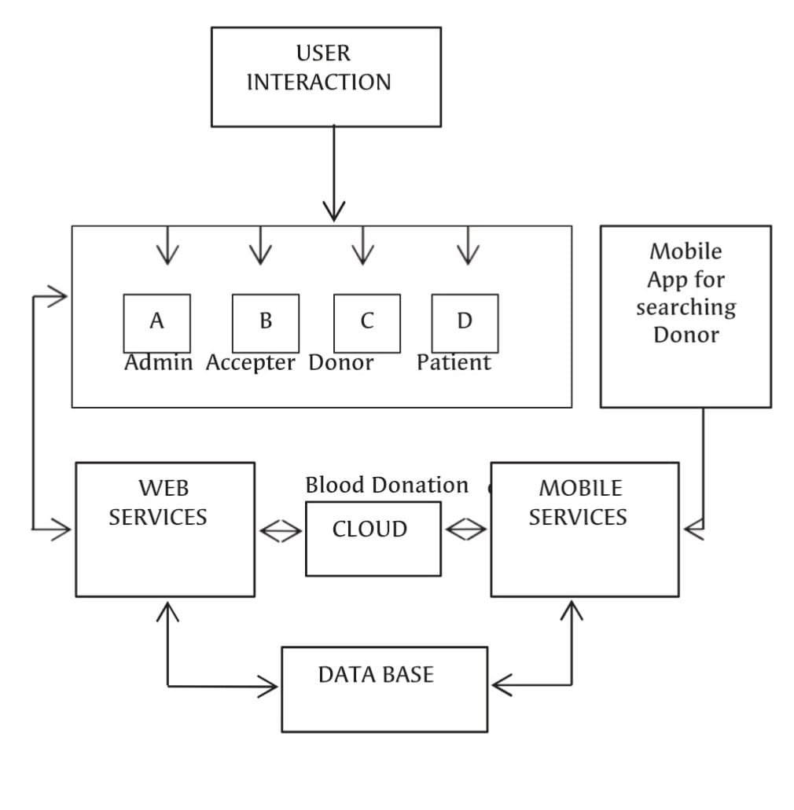
System design

Slide 14
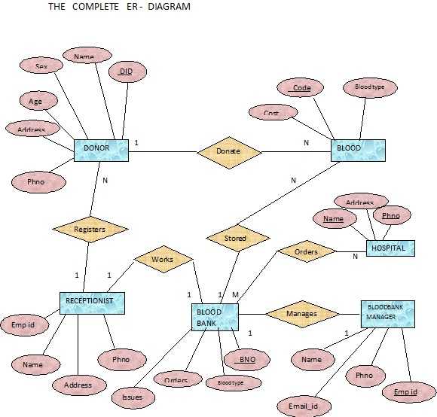
System design

Slide 15
Methodology
Given are the modules for the Android Blood Bank.
Admin Module: In this module, the administration work is done such as insertion and updation of new details, deletion of old details and so on.
User Module: In this module, users use to do their task such as registering themselves as an account member, getting details by filtering of their own choices,
Database Module: Here, in this module, all the database is maintained and queries are being executed. Every database has its own table which contains rows and tuple and every relation is being handles using SQL queries, given either by user in the form of statement or else by admin.
Content Module: In this module, some basic content will be share after each time limit, for regular updation regarding blood disease and its curing periods.

Slide 16
Methodology(Cont.)
The result of this application is can be expressed in following steps.
Stage 1: If User is enrolled then give User Id (I) and secret key (P) else Create new record.
Stage 2: While blood stock gets low notice will be sent to contributors for blood gift camp.
Stage 3: Demand from client for blood, will be shown in the database.
Stage 4: Check for blood accessibility at blood donation center.
Stage 5: If blood isn't accessible send notice from blood donation center to the enrolled Donors.
Stage 6: Check conditions for blood gift,different variables and past history.
Stage 7: If conditions are fulfilled acknowledge it.
Stage 8: If Conditions are not fulfilled at that point send warning to different contributors who are qualified.

Slide 17
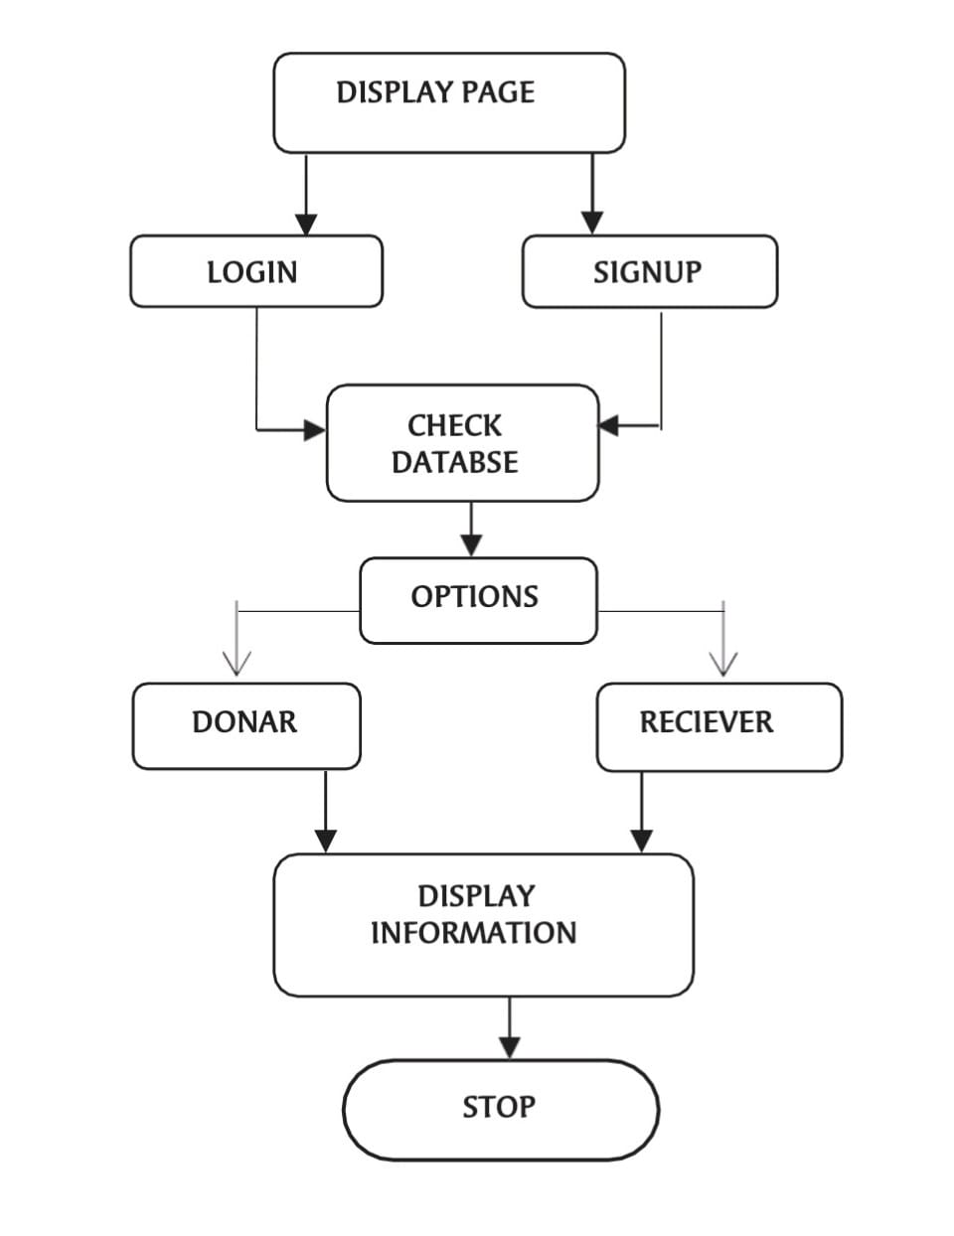
Methodology(Cont.)

Slide 18
Experimental Result
Right now it has been put on application improvement for versatile gadgets. The application created is an alluring application helpful for clients having low gadget memory in applications. This application can be downloaded in any android forms above than 4.1 (Jellybean).
Expanded commitment and communications: This ready to assist the client with accessing the application so effectively which does excludes any pop-ups, standards and so forth. Client may draw in with their own errand and at the same time can see the entire year exchange reports.
Moment Access: App doesn't require a lot of time to open and play out its undertaking.
Expanded security with existing frameworks: It stores all the information in a database which is verify information and can be seen through hard and fast the months with no issue.
Progressively effective business process: Mobile applications offer speedy data and moment backing to clients constantly and wherever they required. Numerous new advancements,eg. push cautions may likewise be sent to their cell phones when new information or updates are accessible.

Slide 19
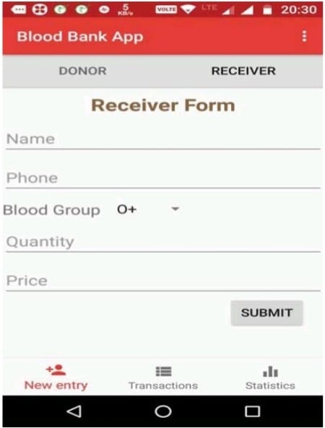
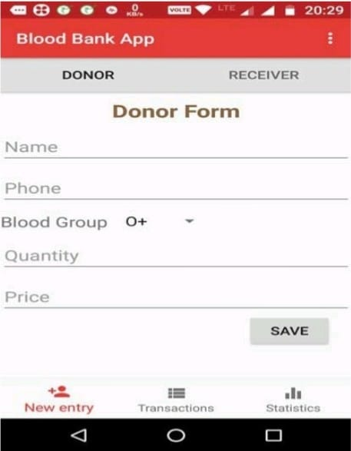
Experimental Result

Slide 20
Applications
This application can be used by any common people.
The application can prove very beneficial in to the clinics, hospitals as the requirement is very high in such places.
This application will use Firebase Realtime Database to collect and organize information of blood donors with fast and efficent search.
This application will be very useful for finding blood donors in emergencies.
Rare blood groups could be easily found.
This application will provide all information of the donor including all past health related issues
This automated Blood Bank Android Project will reduce the time and efforts for finding the right choice of donor for the needy receiver and thus most of the times helps the person to save his/her life also.

Slide 21
Applications(Cont.)
The proposed Blood Bank Android Project system will help the needy person, access to all the donors of the blood of the particular group, nearby to their place, in a minutes of time. The details will include the name of the donor, his/her blood group, contact number and address
This Blood Bank Android Project system will specify all the details related to the donor such as their name, their address, their mobile number, their blood group and so on. The one who need blood, just have to login into the system which will hardly take few seconds and then the one who needs the blood get access to all the available group of bloods in nearby blood banks as well as details of those who can donate blood in urgent.

Slide 22
Conclusion
The proposed Android Application is easy to understand and simple to use when contrasted with existing blood donation center applications. In existing interfaces their insights shows what number of units of required blood bunch are accessible. The reports area shows the month wherein blood bunch are being appropriated and gotten. Right now name enrollment, telephone no and blood bunches should be given are incorporated. It likewise incorporates the blood amount to be put away in the application database. This can be called as new section as a client may enter his/her subtleties in the database. While in the recipient's structure this has person's name, telephone no (which a client can contact), their blood bunches should be gotten and the aggregate sum of amount. In the wake of presenting these information in the database, these fields are noticeable during exchange process.

Slide 23
Future Enhancement
The current web based system’s in India for Blood Bank are not available according to the user’s requirement as they are deployed on web which are handy to use as they can be accessed in the case of emergency or an trauma Situation. The Mobility provided By Android based system which is accessible on mobile through Application are available on the go.
Location Accuracy Web based system provides the list of Blood banks with unique Identifier in nearest city, which is not that feasible as compared to direct access of mobile application as that of surfing the internet on personal system. Using GPS location identification of the applicant towards the blood bank application will provide location and path for nearest blood bank system.

Slide 24
Future Enhancement
Highly Trained Dataset Dataset Training i.e., data storage, manipulation, service etc., provides a great supporting model for the Application. The filtered dataset in which is uniformly structured helps end user to access this information and make fruit from it.The key features and information are date of birth of the donor as well as patient, blood group of the patient/ donor, date of last blood donated, mobile number, address with city and state, email id. It provides the criteria according hospital, blood bank wise advance search for the list and retrieval of data.
Alert System In case of emergency were the availability of blood is not known and the time is the major concern for user as they cannot manually search for required blood from each hospital and blood banks. So the Application provides an alert button which as soon as is clicked the information according to the best search attribute id displayed to the user profile with the nearest hospital and blood bank with its route to the destination.

Slide 25
References
[1] Vikas Kulshreshtha and Sharad Maheshwari, “Benefits of Management Information System in Blood Bank”, International Journal of Engineering and Science, Vol. 1, Issue 12, PP 05-07, 2012.
[2] Hayes, Helen and Onkar Sharma, "A decade of experience with a common first year program for computer science, information systems and information technology majors". Journal of Computing Sciences in Colleges, Vol. 18, No. 3 pp. 217–227, 2003.
[3] Polack, Jennifer, "Planning a CIS Education Within a CS Framework". Journal of Computing Sciences in Colleges, Vol. 25, No. 2, pp. 100–106, 2009.
[4] J. Scott Armstrong, "The Value of Formal Planning for Strategic Decisions: A Reply". Strategic Management Journal, Vol. 7, pp. 183–185, 1986.
[5] Sayali Dhond, Pradnya Randhavan, Bhagyashali Munde, Rajnandini Patil, and Vikas Patil, “Android Based Health Application in Cloud Computing For Blood Bank”, International Engineering Research Journal (IERJ) Volume 1 Issue,2015.
[6] T.Hilda Jenipha and R.Backiyalakshmi, “Android Blood Donor Life Saving Application in Cloud Computing”, American Journal of Engineering Research (AJER), Volume 03, Issue 02, pp. 105-108, 2014.

Slide 26
Implementation
For front-end design:
HTML
CSS
For back-end design:
PHP
Other steps:
Database is created using MYSQL
Database is uploaded to a local apache server (XAMPP)
Admin can retrieve, modify, delete data and can access the Local Server

Slide 27
<body background="bloodcell.jpg"> <h2><center><font color="Turquoise" size="10" style="text-shadow:2px 2px;font-style:oblique;"><marquee width=670>Register as a blood donor</marquee></font></center></h2><br> <div> <center><h2><font color="Turquoise" style="text-shadow:1px 1px;font-style:italic;">Personal information</font></h2></center> <form style="width: 500px;height: 700px; border: 1px solid pink;border-radius:10px;border-width:10px;border-spacing:5px; overflow:auto;margin-left: 400px;padding: 10px;"> <center><font color="yellow">Enter your first name:</font></center><br> <center><input type="text" name="Fname" id="name" placeholder="First name"></center><br> <center><font color="yellow">Enter your last name:</font></center><br> <center><input type="text" name="Lname" id="name" placeholder="Last name"></center><br> <center><l<body background="bloodcell.jpg"> <h2><center><font color="Turquoise" size="10" style="text-shadow:2px 2px;font-style:oblique;"><marquee width=670>Register as a blood donor</marquee></font></center></h2><br> <div> <center><h2><font color="Turquoise" style="text-shadow:1px 1px;font-style:italic;">Personal information</font></h2></center> <form style="width: 500px;height: 700px; border: 1px solid pink;border-radius:10px;border-width:10px;border-spacing:5px; overflow:auto;margin-left: 400px;padding: 10px;"> </center> <center><h4><font color="yellow">Descibe,if any diseases you have:</font><br></h4></center> <center><textarea rows="4" cols="40" placeholder="Descibe if any..."></textarea></center><br><br> <button type="button" style="background-color:tomato; margin-left:auto;margin-right:auto;display:block;margin-top:1%;margin-bottom:1%; font-size: 20px;font-style:oblique;">Submit</button> </form> </div> <br> <div> <center><h2><font color="Turquoise" style="font-style:italic;">contact information</font></h2></center> <form style="width: 500px;height: 570px; border: 1px solid pink;border-radius:10px;border-width:10px;border-spacing:5px; overflow:auto;margin-left: 400px;padding: 10px;"> <br> <center><font color="yellow">Enter your email address:</font></center><br> <center><input type="email" name="email address" placeholder="email" style="width:250px" required></center><br> <center><font color="yellow">Enter your phone number:</font></center><br> <center><input type="tel" name="usrtel" placeholder="phone number"></center><br> <center><font color="yellow">Enter your address:</font></center><br> <center><textarea rows="4" cols="40" placeholder="your address..."></textarea></center><br> <center><font color="yellow">Enter city:</font></center> <center><select name="dropdown"><option value="Bangalore" selected>Bangalore</option><option value="kolkata" selected>Kolkata
Pseudo-code

Slide 28
Thank You

